Slide 1





SJB INSTITUTE OF TECHNOLOGY
BGS Health & Education City, Kengeri , Bangalore – 60 .
║JAI SRI GURUDEV║
Sri AdichunchanagiriShikshana Trust (R)
DEPARTMENT OF ELECTRONICS & COMMUNICATION ENGINEERING
Technical seminar
on
Review of Machine Learning Techniques for EEG Based Brain Computer Interface
By:
Varshini K R [1JB18EC106]
Under the Guidance of
Mrs. Supriya M
Assistant Professor
Dept. of ECE,
SJBIT

Slide 2
Contents
Introduction
Literature Survey
Challenges
Objective
EEG Cap and Electrode Placement
Methodology
Classification of types of BCI
Machine learning techniques
Classification methods
Conclusion
References
UG Project/ECE/SJBIT
2

Slide 3

Introduction
The BCI is a communication and control system established between the CNS(s central nervous system) and its external or internal environment
BCI is a collaboration in which brain accepts and controls a mechanical device as a natural part of its representation of the body.
It is a device that makes humans bind their brains to computers, allowing people to generate brain waves that are converted into commands for the applications they are designed for
UG Project/ECE/SJBIT
EEG is used in BCI because of its high time resolution, relative use of brain signal acquisition and non-invasive in nature.
3

Slide 4
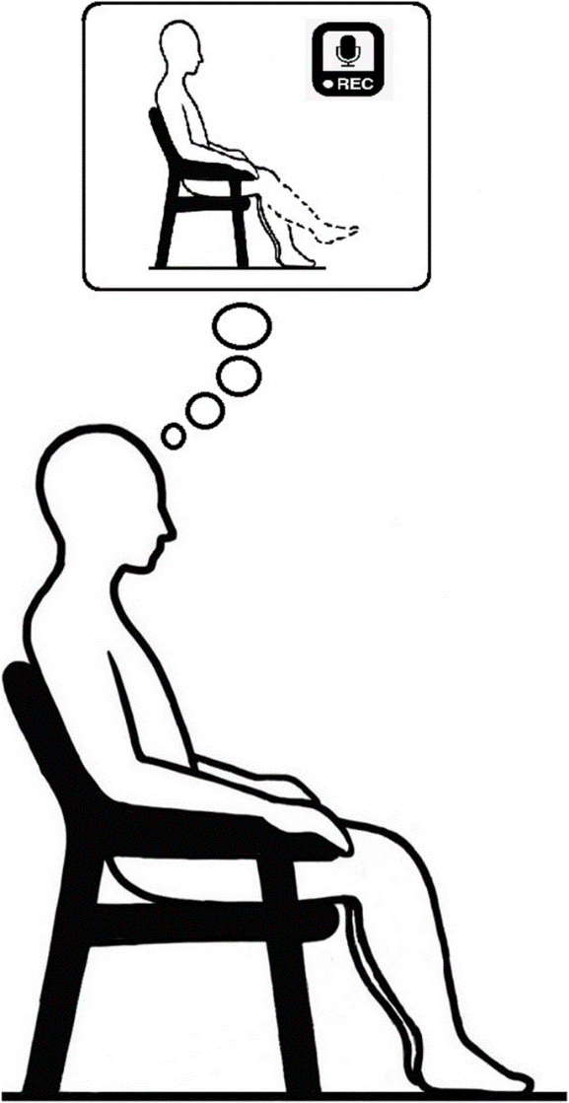
Motor imagery
Thinking or imagination-based activities
are known as Motor Imagery(MI) activities.
MI involves imagining a moving body part without any actual movement of muscles in body.
UG Project/ECE/SJBIT
the different rhythms of the brain such as Beta (14-30 Hz), Alpha (8-13 Hz), Theta (4-7 Hz), and Delta (1-3 Hz) which differ in their frequency ranges, state of mind.
This interface can be based on brain activity during muscular movements or the changes of the rhythms of brain signals
4

Slide 5
Literature survey
Title and Autors with Year estaiblished | Machine learning techniques | performance
Baig MZ, Aslam N, Shum HP, Zhang L (2017) Differential evo- lution algorithm as a tool for optimal feature subset selection in motor imagery | SVM, K-NN, Naïve Bayes | Accuracy: 90.4%
Islam MR, Tanaka T, Akter MS, Molla MKI (2017) Classifica- tion of motor imagery BCI using multiband tangent space map- ping. In: 2017 22nd International conference on digital signal processing (DSP). IEEE | SVM | Accuracy: 83.82%
Lee HK, Choi YS (2018) A convolution neural networks scheme for classification of motor imagery EEG based on wavelet time- frequency image. In: 2018 International conference on informa- tion networking (ICOIN). IEEE | CNN | Accuracy: 78.93%
Rashid M, Bari BS, Hasan MJ, Razman MAM, Musa RM, Ab Nasir AF, Majeed APA (2021) The classification of motor imagery response: an accuracy enhancement through the ensem- ble of random subspace k-NN | k-nearest neighbor (k-NN) | Accuracy: 95.21%
UG Project/ECE/SJBIT
5

Slide 6
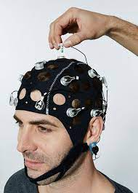
CHALLENGES
Understanding of the electrode placement on the scalp to acquire signals
for a specific task.
As EEG signals are non-stationary in nature, removing of noise and artefacts are essential.
Feature selection is important for better classification
UG Project/ECE/SJBIT
6

Slide 7
OBJECTIVES
Acquiring of brain signals, to analyze and interpret the properties of EEG
signals.
To classify motor imagery activities like elbow, wrist, finger movements using machine learning techniques.
To develop an intelligent BCI based prosthesis with all the basic functions displayed by the human hand.
UG Project/ECE/SJBIT

Slide 8
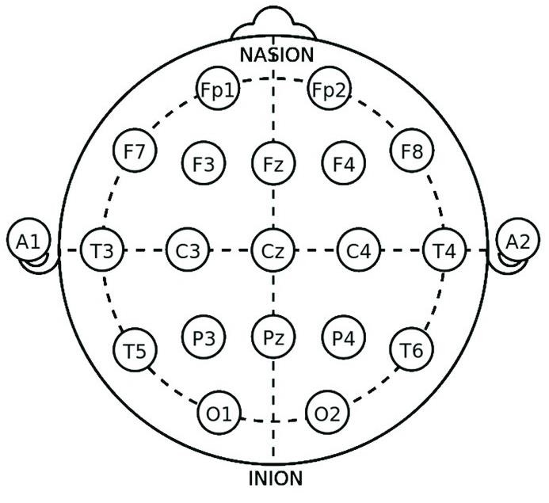
EEG Cap and Electrode Placement
The position of the electrodes on the scalp is based on the International 10-20 system. Non-invasive method.
F – frontal lobe
C – central lobe
P - parietal lobe
O – occipital lobe
T – temporal lobe
UG Project/ECE/SJBIT
Fig – International 10/20 system for
electrode placement

Slide 9
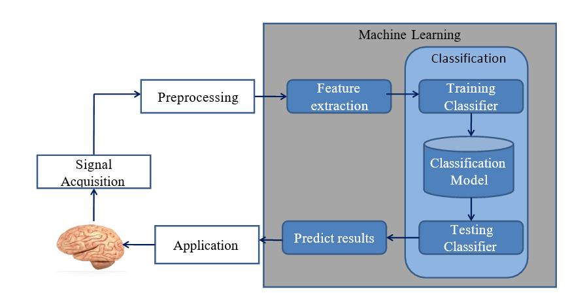
Methodology

Slide 10
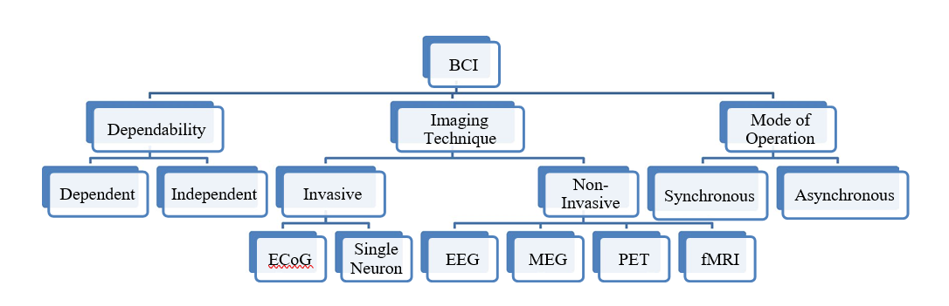
Clasification of types of BCI

Slide 11
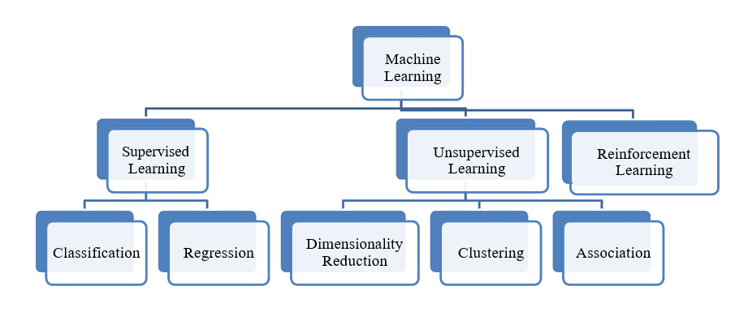
Categorization of Machine learning techniques

Slide 12
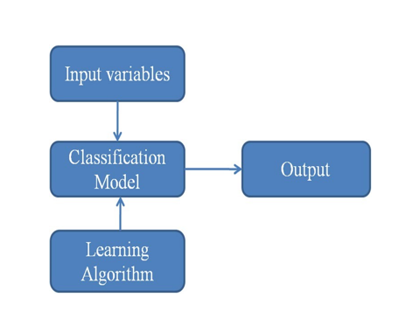
The various computational methods that use machine learning techniques for the classification of motor imagery, P300, and SSVEP signals.
In the training process, a learning algorithm is used to learn the rules, which is then fed into a classification model for testing process
Methods /Technology used in this paper are,
Machine Learning in MI Based BCI
Machine Learning in P300 Based BCI
Machine Learning in SSVEP Based BCI

Slide 13
Classification
Classification is the process of predicting the class of given
data points.
Task of approximating a mapping function (f) from input variables (X) to discrete output variables (y).
Types of Classifiers :
K-Nearest Neighbor
Support Vector Machine
CNN
UG Project/ECE/SJBIT

Slide 14
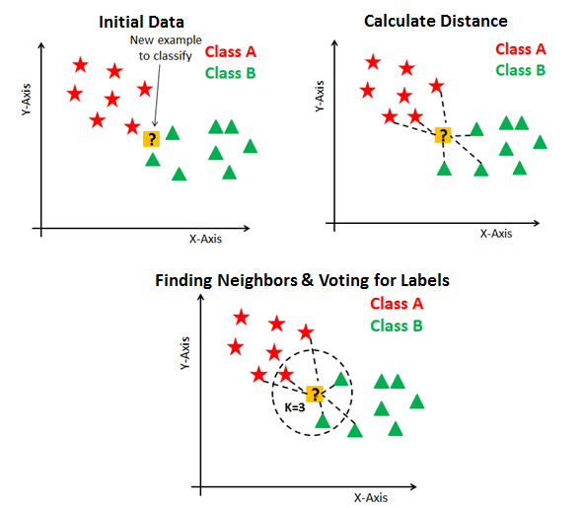
Classification
1. K-Nearest Neighbor
It is a simplest machine learning algorithm based on supervised learning technique.
It is a lazy learner algorithm.
K-NN is a non-parametric algorithm.
KNN algorithm at the training phase just stores the dataset and when it gets new data, then it classifies that data into a category that is much similar to the new data.
K denotes the count of nearest neighbor.
To calculate distance between datapoints: Euclidean distance, Manhattan
UG Project/ECE/SJBIT

Slide 15
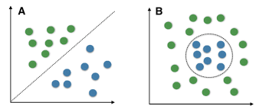
Classification
2. Support Vector Machine
It is a Supervised Learning algorithms used for classification and regression problems.
SVM algorithm -
The algorithm creates a decision boundary that can segregate n- dimensional space into classes.
The best boundary is the hyperplane of SVM having maximum distance between datapoints.
The closest datapoint to the hyperplane are called as support vectors.
UG Project/ECE/SJBIT
iii.
The generation of 3 lines separates the classes very accurately and clearly.

Slide 16
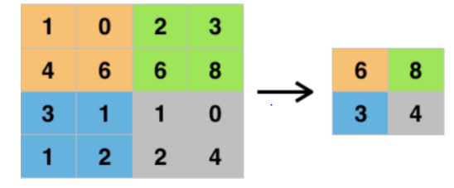
Classification
3. CNN(Convolutional Neural network)
Convolutional Neural Network or CNN is a type of artificial neural network, which is widely used for image/object recognition and classification. Deep Learning thus recognizes objects in an image by using a CNN.
A Convolutional neural network (CNN) is a neural network that has one or more convolutional layers and are used mainly for image processing, classification, segmentation and also for other auto correlated data

Slide 17
Result and Conclusion
The challenges pertaining to EEG-based BCI were identified and categorized according to signal processing, BCI functioning, performance assessment, and commercialization
To develop an efficient BCI model that will be able to assit people with lost limbs using Robotic prosthetic by analysing the brain signals for MI tasks

Slide 18
References
Ramadan RA, Vasilakos AV (2017) Brain computer interface: control signals eview. Neurocomputing
Aricò P, Borghini G, Di Flumeri G, Sciaraffa N, Babiloni F (2018) Passive BCI beyond the lab: current trends and future directions. Physiol Meas
Kamousi B, Amini AN, He B (2007) Classification of motor imagery by means of cortical current density estimation and Von Neumann entropy. J Neural Eng
Birbaumer N (1999) Slow cortical potentials: plasticity, operant control, and behavioral effects. Neuroscientist
Hoffmann U, Vesin JM, Ebrahimi T, Diserens K (2008) An effi- cient P300-based brain–computer interface for disabled subjects. J Neurosci Methods
Middendorf M, McMillan G, Calhoun G, Jones KS (2000) Brain- computer interfaces based on the steady-state visual-evoked response. IEEE Trans Rehabil Eng
Huang D, Qian K, Fei DY, Jia W, Chen X, Bai O (2012) Electro- encephalography (EEG)-based brain–computer interface (BCI): a 2-D virtual wheelchair control based on event-related desynchro- nization/synchronization and state control. IEEE Trans Neural Syst Rehabil Eng
Höhne J, Tangermann M (2014) Towards user-friendly spell- ing with an auditory brain-computer interface: the charstreamer paradigm. PLoS
Kwak NS, Müller KR, Lee SW (2015) A lower limb exoskeleton control system based on steady state visual evoked potentials. J Neural Eng
Wolpaw JR, Wolpaw EW (2012) Brain-computer interfaces: something new under the sun. Brain–computer interfaces: prin- ciples and practice
Vidal JJ (1973) Toward direct brain–computer communication. Annu Rev Biophys Bioeng
Fetz EE (1969) Operant conditioning of cortical unit activity.
13. Delgado JMR (1969) Physical control of the mind: toward a psy- chocivilized society, vol 41. World Bank Publications
UG Project/ECE/SJBIT
29

Slide 19


